Slide 1
WEEK 5 Lab meeting
Doan Manh Hung
Sep 26th, 2014

Slide 2
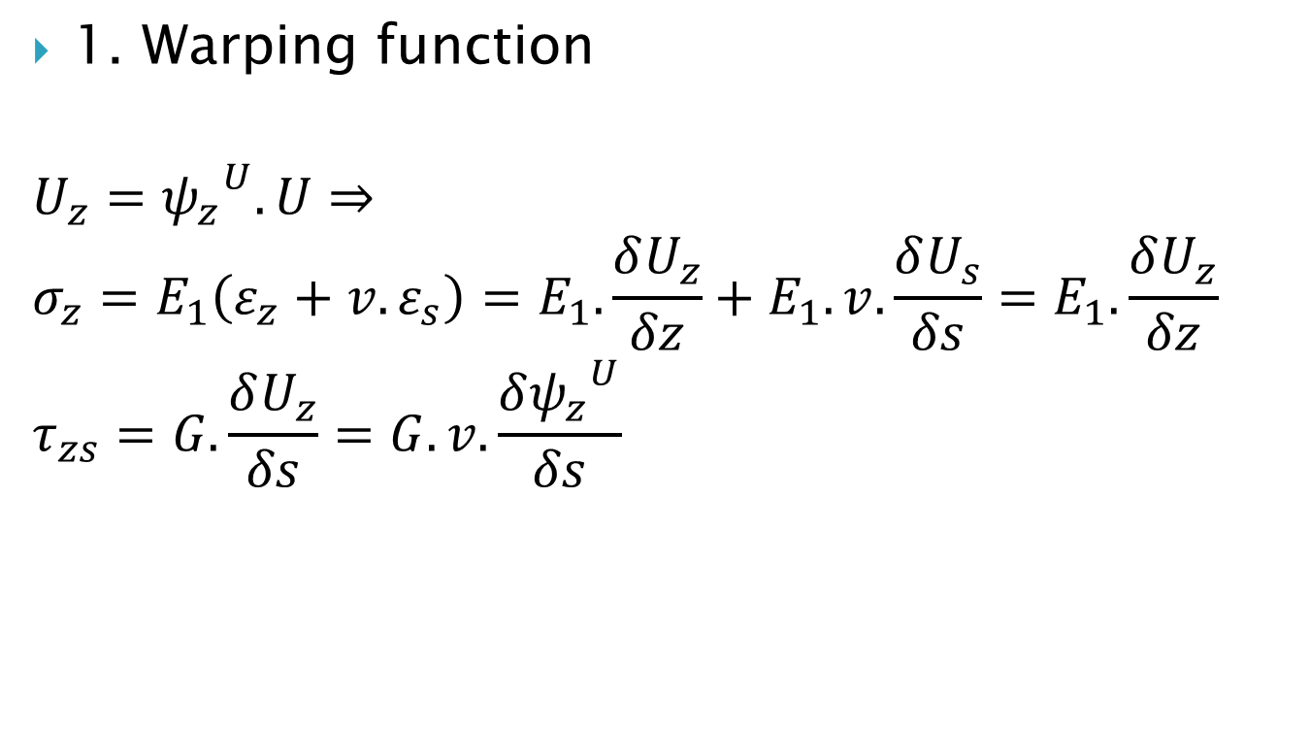
Torsion Shape Function
1. Warping function
$$U_{z}={ψ_{z}}^{U}.U⇒$$
$$σ_{z}=E_{1}\left(ε_{z}+v.ε_{s}\right)=E_{1}.\frac{δU_{z}}{δz}+E_{1}.v.\frac{δU_{s}}{δs}=E_{1}.\frac{δU_{z}}{δz}$$
$$τ_{zs}=G.\frac{δU_{z}}{δs}=G.v.\frac{δ{ψ_{z}}^{U}}{δs}$$

Slide 3

Warping shape function
$F_{z}=\int_{A}{σ_{z}dA}=E_{1}.\int_{A}{{ψ_{z}}^{U}.U′dA}=0$
$⇒\int_{A}{{ψ_{z}}^{U}.dA=0}$ $(1)$
$F_{x}=\int_{A}{τ_{zx}}.dA=0$
$F_{y}=\int_{A}{τ_{zy}}.dA=0$
Fy
My
Fx
Mx
Mz
Fz

Slide 4
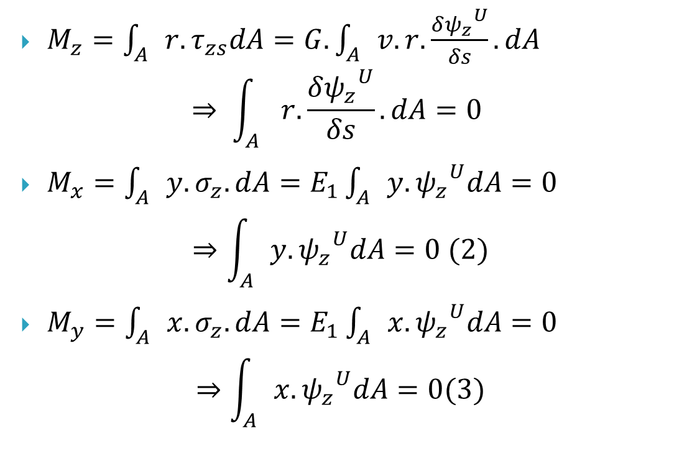
Warping shape function
$M_{z}=\int_{A}{r.τ_{zs}dA}=G.\int_{A}{v.r.\frac{δ{ψ_{z}}^{U}}{δs}.dA}$
$$⇒ \int_{A}{r.\frac{δ{ψ_{z}}^{U}}{δs}.dA}=0$$
$M_{x}=\int_{A}{y.σ_{z}.dA}=E_{1}\int_{A}{y. {ψ_{z}}^{U}dA}=0$
$$⇒\int_{A}{y.{ψ_{z}}^{U}dA}=0 (2)$$
$M_{y}=\int_{A}{x.σ_{z}.dA}=E_{1}\int_{A}{x. {ψ_{z}}^{U}dA}=0$
$$⇒\int_{A}{x.{ψ_{z}}^{U}dA}=0(3)$$

Slide 5





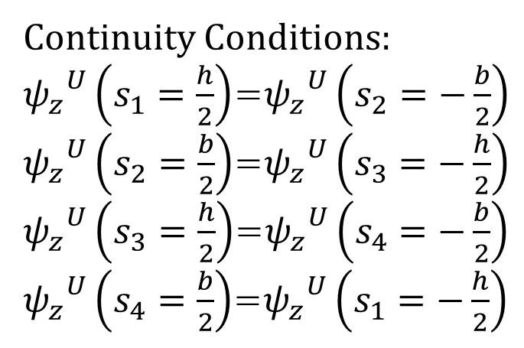

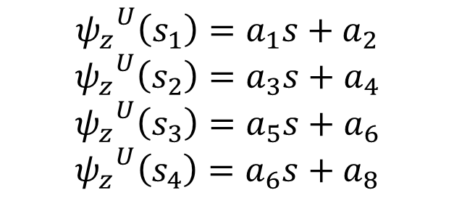


Warping shape function
$${ψ_{z}}^{U}\left(s_{1}\right)=a_{1}s+a_{2}$$
$${ψ_{z}}^{U}\left(s_{2}\right)=a_{3}s+a_{4}$$
$${ψ_{z}}^{U}\left(s_{3}\right)=a_{5}s+a_{6}$$
$${ψ_{z}}^{U}\left(s_{4}\right)=a_{6}s+a_{8}$$
$$edge2$$
$$s_{2}$$
Continuity Conditions:
${ψ_{z}}^{U}\left(s_{1}=\frac{h}{2}\right)$=${ψ_{z}}^{U}\left(s_{2}=−\frac{b}{2}\right)$
${ψ_{z}}^{U}\left(s_{2}=\frac{b}{2}\right)$=${ψ_{z}}^{U}\left(s_{3}=−\frac{h}{2}\right)$
${ψ_{z}}^{U}\left(s_{3}=\frac{h}{2}\right)$=${ψ_{z}}^{U}\left(s_{4}=−\frac{b}{2}\right)$
${ψ_{z}}^{U}\left(s_{4}=\frac{b}{2}\right)$=${ψ_{z}}^{U}\left(s_{1}=−\frac{h}{2}\right)$
$$s_{1}$$
$$edge3$$
$$s_{3}$$
$$edge1$$
$$s_{4}$$
$$edge4$$
Warping

Slide 6
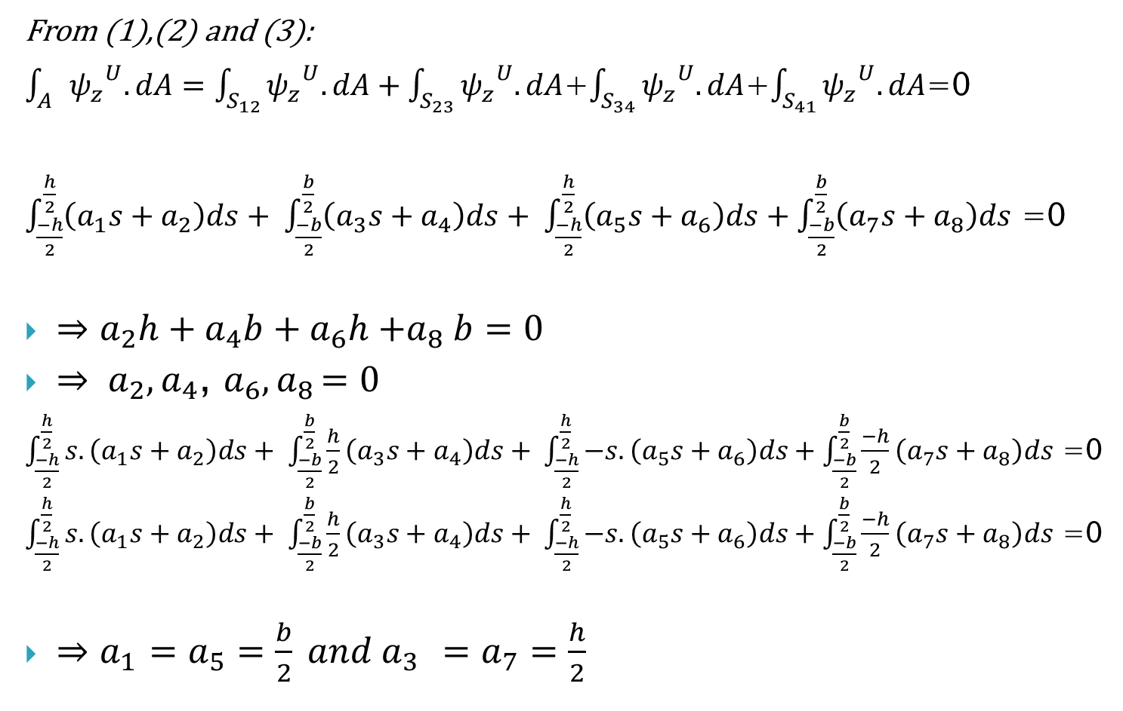
From (1),(2) and (3):
$\int_{A}{{ψ_{z}}^{U}.dA}=\int_{S_{12}}{{ψ_{z}}^{U}.dA}+\int_{S_{23}}{{ψ_{z}}^{U}.dA}$+$\int_{S_{34}}{{ψ_{z}}^{U}.dA}$+$\int_{S_{41}}{{ψ_{z}}^{U}.dA}$=0
$\int_{\frac{−h}{2}}^{\frac{h}{2}}{\left(a_{1}s+a_{2}\right)ds}+ \int_{\frac{−b}{2}}^{\frac{b}{2}}{\left(a_{3}s+a_{4}\right)ds}+ \int_{\frac{−h}{2}}^{\frac{h}{2}}{\left(a_{5}s+a_{6}\right)ds}+\int_{\frac{−b}{2}}^{\frac{b}{2}}{\left(a_{7}s+a_{8}\right)ds}$ =0
$⇒a_{2}h+a_{4}b+a_{6}h{+a}_{8}b=0$
$⇒ a_{2},a_{4}$, $a_{6}{,a}_{8}=0$
$\int_{\frac{−h}{2}}^{\frac{h}{2}}{s.\left(a_{1}s+a_{2}\right)ds}+ \int_{\frac{−b}{2}}^{\frac{b}{2}}{\frac{h}{2}\left(a_{3}s+a_{4}\right)ds}+ \int_{\frac{−h}{2}}^{\frac{h}{2}}{−s.\left(a_{5}s+a_{6}\right)ds}+\int_{\frac{−b}{2}}^{\frac{b}{2}}{\frac{−h}{2}\left(a_{7}s+a_{8}\right)ds}$ =0
$\int_{\frac{−h}{2}}^{\frac{h}{2}}{s.\left(a_{1}s+a_{2}\right)ds}+ \int_{\frac{−b}{2}}^{\frac{b}{2}}{\frac{h}{2}\left(a_{3}s+a_{4}\right)ds}+ \int_{\frac{−h}{2}}^{\frac{h}{2}}{−s.\left(a_{5}s+a_{6}\right)ds}+\int_{\frac{−b}{2}}^{\frac{b}{2}}{\frac{−h}{2}\left(a_{7}s+a_{8}\right)ds}$ =0
$⇒a_{1}$ $=a_{5}=\frac{b}{2} and{ a}_{3} =a_{7}=\frac{h}{2}$

Slide 7
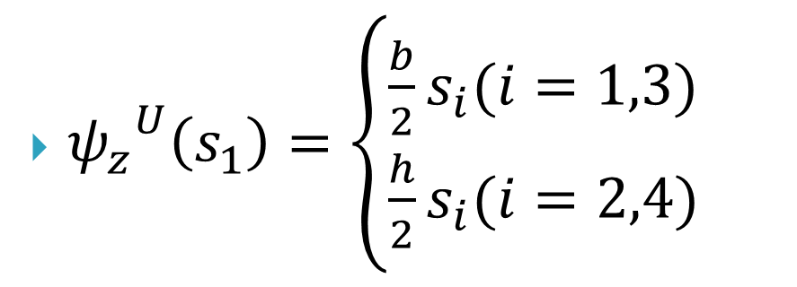
Warping shape functions
${ψ_{z}}^{U}\left(s_{1}\right)=\left\{\begin{aligned}\frac{b}{2}s_{i}(i=1,3) \\ \frac{h}{2}s_{i}(i=2,4)\end{aligned}\right.$

Slide 8
Going to do in next week:
Finish the examples in paper 1999

